Slide 1
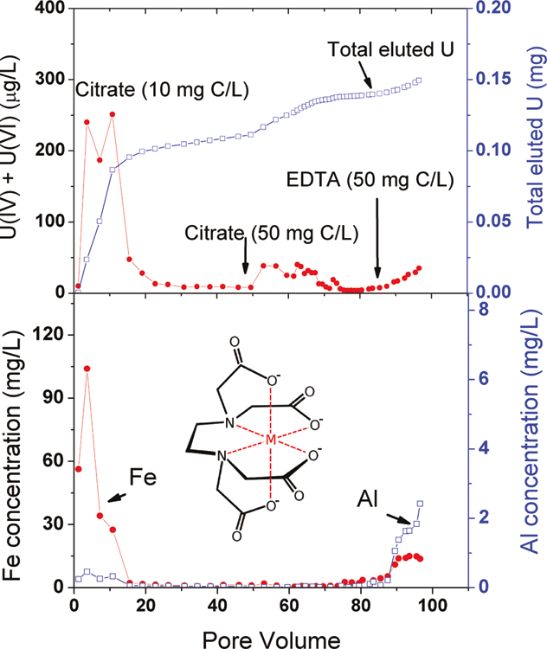
Organic ligands can Cause Uranium Dissolution and Mobilization even under Strong Reducing Conditions Contact: Baohua Gu, 865-574-7286 or gub1@ornl.gov
DOE/Office of Science/Biological & Environmental Research
Reductive precipitation of uranium (U) by in situ microbial reduction has been proposed as one of the effective means to immobilize U at DOE contaminated sites
However, organic complexing ligands pose concerns on the long-term stability and mobility of uranium because they can solubilize U and U-bearing minerals
This study found that ethylenediaminetetraacetate (EDTA) and citrate enhance dissolution of U as well as iron and aluminum minerals and thus cause increased mobilization of U even under anaerobic conditions
Complexing organic ligands may thus present a challenge in maintaining the long-term stability of U and should be considered in future design of remedial strategies at contaminated sites
Increased dissolution/mobility of U
Increased dissolution of Fe and Al
Luo, W. and Gu, B. 2011. Environ. Sci. Technol. 108, DOI: 10.1021/es103073u.

Slide 2
Organic ligands can Cause Uranium Dissolution and Mobilization even under Strong Reducing Conditions Contact: Baohua Gu, 865-574-7286 or gub1@ornl.gov
DOE/Office of Science/Biological & Environmental Research
The stability and mobility of uranium (U) is a concern following its reductive precipitation or immobilization by techniques such as bioremediation at contaminated sites. In this study, the influences of complexing organic ligands such as citrate and ethylenediaminetetraacetate (EDTA) on the mobilization of U were investigated in both batch and column flow systems using a contaminated and bioreduced sediment from the Integrated Field Research Challenge (IFRC) site in Oak Ridge, TN. Results indicate that both reduced U(IV) and oxidized U(VI) in the sediment can be effectively mobilized with the addition of EDTA or citrate under anaerobic conditions. The dissolution and mobilization of U appear to be correlated to the dissolution of iron (Fe)- or aluminum (Al)-bearing minerals, with EDTA being more effective than citrate in dissolving these minerals. The column flow experiments confirm that U, Fe, and Al can be mobilized by these ligands under anoxic conditions, although the cumulative amounts of U removal constituted ~0.1% of total U present in this sediment following a limited period of leaching. This study concludes that the presence of complexing organic ligands may pose a long-term concern by slowly dissolving U-bearing minerals and mobilizing U even under a strict anaerobic environment.
Luo, W. and Gu, B. 2011. Dissolution of uranium-bearing minerals and mobilization of uranium by organic ligands in a biologically reduced sediment. Environ. Sci. Technol. 108, (in press) DOI: 10.1021/es103073u.

